Slide 1
Lecture 22: Support Vector Machine
Instructor: Yang Xu
Slides inspired by Learning From Data (CalTech), Yaser S. Abu-Mostafa

Slide 2
Outline
Decision boundary and margin
Solution

Slide 3
Introduction
Support vector machine (SVM)
Among the best “off-the-shelf” supervised learning algorithm
Vapnick, 1995

Slide 4
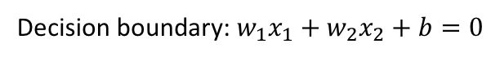
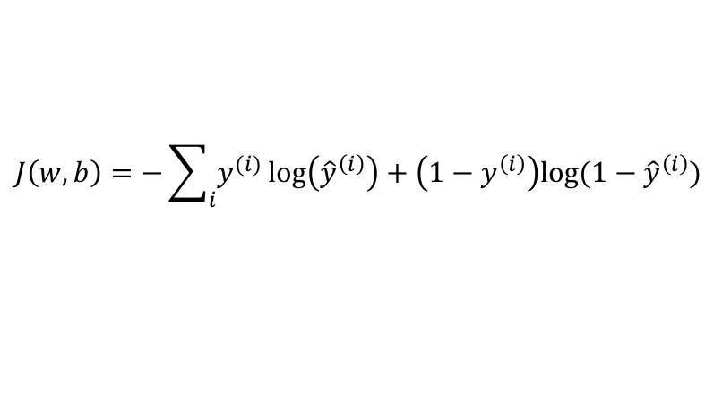
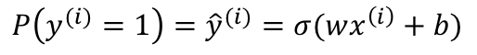
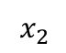
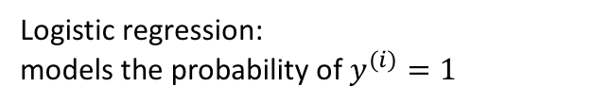
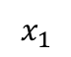
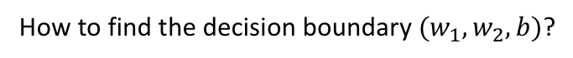
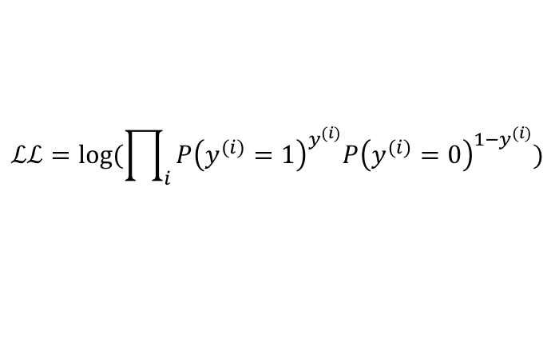
Classification problem = drawing a decision boundary
$$x_{2}$$
How to find the decision boundary $(w_{1},w_{2},b)$?
Logistic regression:
models the probability of $y^{(i)}=1$
$$P\left(y^{(i)}=1\right)={\hat{y}}^{(i)}=σ(wx^{\left(i\right)}+b)$$
Learn the parameters $w, b$ that minimize the cost
$$J\left(w,b\right)=−\sum_{i}{y^{(i)}\log\left({\hat{y}}^{\left(i\right)}\right)+\left(1−y^{\left(i\right)}\right)log⁡(1−{\hat{y}}^{\left(i\right)})}$$
Equivalent to maximizing the log likelihood of data:
$$x_{1}$$
$$ℒℒ=log⁡(\prod_{i}{{P\left(y^{(i)}=1\right)}^{y^{(i)}}{P\left(y^{(i)}=0\right)}^{1−y^{(i)}}})$$
Decision boundary: $w_{1}x_{1}+w_{2}x_{2}+b=0$

Slide 5

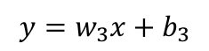
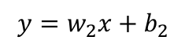
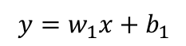
Another way of viewing the linear separation
$$y=w_{1}x+b_{1}$$
$$y=w_{2}x+b_{2}$$
$$y=w_{3}x+b_{3}$$
Which one is best?
Why is bigger margin better?
How to find the $w$ that maximizes the margin

Slide 6
Margin and the performance of a classifier
A wider margin is more robust to unobserved data, and outliers

Slide 7
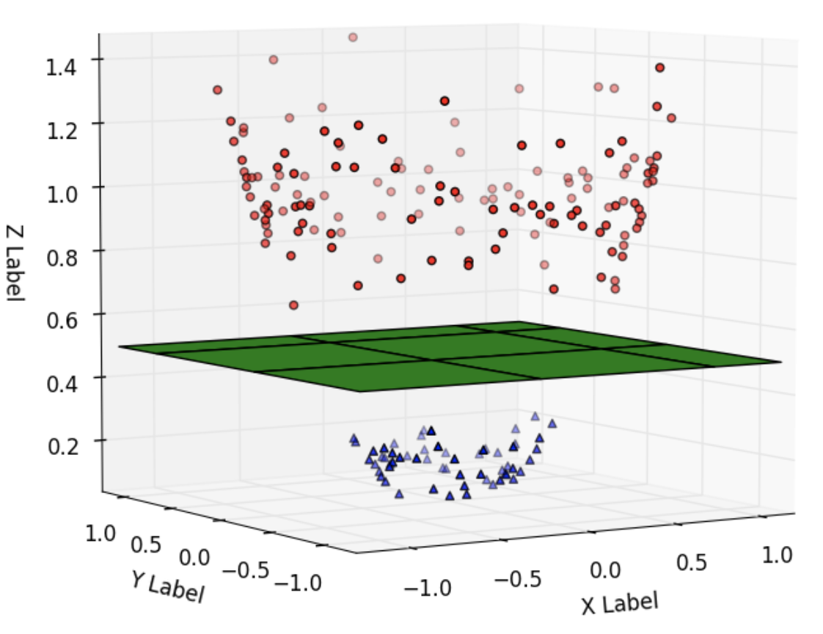
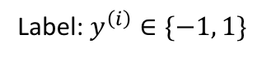
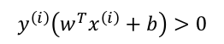
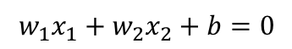
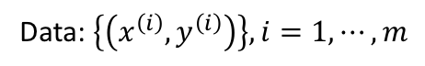
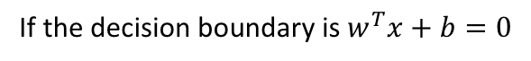
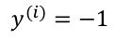
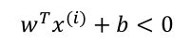
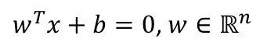
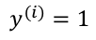
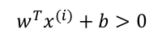
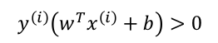
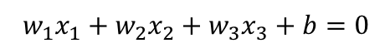
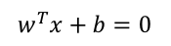
Notations
For 2-D data, decision boundary is a line:
$$w_{1}x_{1}+w_{2}x_{2}+b=0$$
For 3-D data, decision boundary is a plane:
$$w_{1}x_{1}+w_{2}x_{2}+w_{3}x_{3}+b=0$$
For higher dimensional data, decision boundary is a hyperplane:
$w^{T}x+b=0$, $w∈ℝ^{n}$
$$w^{T}x+b=0$$
$$y^{\left(i\right)}\left(w^{T}x^{\left(i\right)}+b\right)>0$$
Data: $\left\{\left(x^{\left(i\right)},y^{\left(i\right)}\right)\right\}, i=1,⋯,m$
Label: $y^{\left(i\right)}∈\{−1, 1\}$
$$y^{(i)}=1$$
$$w^{T}x^{(i)}+b>0$$
If the decision boundary is $w^{T}x+b=0$
The constraint for a plane to be a decision boundary
Then for $i=1,⋯,m$, it satisfies $\left|w^{T}x^{(i)}+b\right|>0$
$$y^{(i)}=−1$$
However, a plane can have infinite number of representations:
$$w^{T}x+b=0⇔{2w}^{T}x+2b=0⇔{100w}^{T}x+100b=0⋯$$
Therefore, we need additional constraint
$$w^{T}x^{(i)}+b<0$$
$$y^{\left(i\right)}\left(w^{T}x^{\left(i\right)}+b\right)>0$$

Slide 8
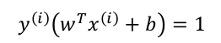
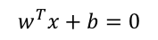
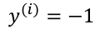
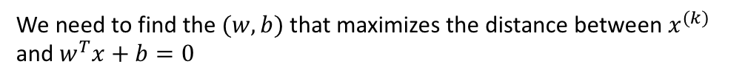
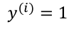
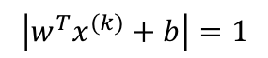
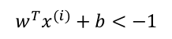
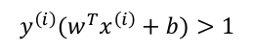
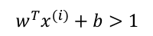
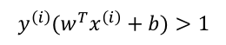
Notations – additional constraint
$$w^{T}x+b=0$$
$$w^{T}x^{(i)}+b>1$$
Let $x^{(k)}$ be the nearest point to the plane $w^{T}x+b=0$
$$y^{(i)}=1$$
$$y^{\left(i\right)}(w^{T}x^{\left(i\right)}+b)>1$$
We place the normalized constraint:
$$\left|w^{T}x^{(k)}+b\right|=1$$
So that the representation for the decision boundary is unique
$$y^{(i)}=−1$$
Next, in order to find the decision boundary that has the largest margin
$$y^{\left(i\right)}\left(w^{T}x^{\left(i\right)}+b\right)=1$$
We need to find the $(w, b)$ that maximizes the distance between $x^{(k)}$ and $w^{T}x+b=0$
$$w^{T}x^{(i)}+b<−1$$
$$y^{\left(i\right)}(w^{T}x^{\left(i\right)}+b)>1$$

Slide 9
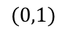
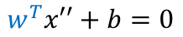
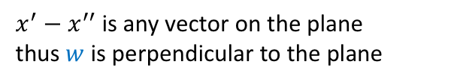
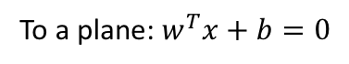
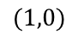
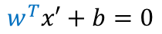
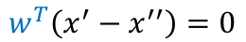

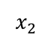
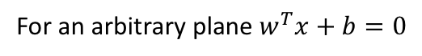
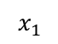
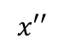
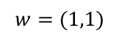

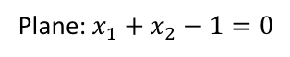
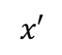
Distance between a point and a plane
To a plane: $w^{T}x+b=0$
For an arbitrary plane $w^{T}x+b=0$
Vector $w$ is perpendicular to the plane
Take any two points on the plane:
Why?
$$w^{T}x′+b=0$$
$$w^{T}x′′+b=0$$
$$x_{2}$$
$$w^{T}\left(x^{′}−x^{′′}\right)=0$$
$x^{′}−x^{′′}$ is any vector on the plane
thus $w$ is perpendicular to the plane
$$(0,1)$$
$$w=(1,1)$$
$$w$$
$$x_{1}$$
$$x′′$$
$$(1,0)$$
Plane: $x_{1}+x_{2}−1=0$
$$x′$$

Slide 10
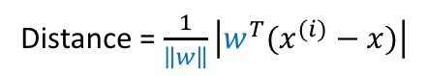













Distance between a point and a plane
$$x^{(i)}$$
Compute the distance between any data point $x^{(i)}$ and the plane:
$$x^{(k)}$$
Take any point on the plane, $x$
Compute the projection of $x^{(i)}−x$ on $w$
$$w$$
Distance = $\frac{1}{\left\|w\right\|}\left|w^{T}(x^{(i)}−x)\right|$
$$=\frac{1}{\left\|w\right\|}\left|w^{T}x^{(i)}−w^{T}x\right|$$
$$=\frac{1}{\left\|w\right\|}\left|w^{T}x^{(k)}+b−w^{T}x−b\right|$$
$$=\frac{1}{\left\|w\right\|}\left|w^{T}x^{(i)}+b\right|$$
$$x$$
0 because $x$ is on the plane
What if $x^{(i)}$ is a special point, $x^{(k)}$, i.e. the nearest point to the plane?
Distance
$$=\frac{1}{\left\|w\right\|}\left|w^{T}x^{(k)}+b\right|$$
$$=\frac{1}{\left\|w\right\|}$$
Maximize this distance so that the margin is maximized
=1 due to the constraint

Slide 11







Optimization problem
$$\frac{1}{\left\|w\right\|}$$
$$\frac{1}{2}w^{T}w$$
Maximize
Minimize
Subject to
$$\min_{i}\left(\left|w^{T}x^{\left(i\right)}+b\right|\right)=1$$
Subject to
$y^{\left(i\right)}(w^{T}x^{\left(i\right)}+b)≥1$, for $i=1,⋯,m$
Notice: $\left|w^{T}x^{\left(i\right)}+b\right|=y^{\left(i\right)}(w^{T}x^{\left(i\right)}+b)$
For points that are nearest to the plane:
$$y^{\left(i\right)}\left(w^{T}x^{\left(i\right)}+b\right)=1$$
For other points:
$$y^{\left(i\right)}\left(w^{T}x^{\left(i\right)}+b\right)>1$$

Slide 12








Solve the constrained optimization problem
Idea: Using Lagrange multiplier
Previously
Construct a Lagrangian:
In PCA:
Maximize sum of squares:
$${\vec{u}}^{T}(\frac{1}{m}\tilde{X}{\tilde{X}}^{T})\vec{u}$$
$$ℒ={\vec{u}}^{T}\left(\frac{1}{m}\tilde{X}{\tilde{X}}^{T}\right)\vec{u}−λ({\vec{u}}^{T}\vec{u}−1)$$
Subject to constraint:
$$\left\|\vec{u}\right\|=1$$
Then, let $\frac{δℒ}{δ\vec{u}}=0$ to solve $\vec{u}$
Equation constraint
Zero form of constrain
In Mixture of Gaussians:
Maximize log-likelihood:
$$\left\lfloor ℒℒ\left(θ\right)\right\rfloor =\sum_{i=1}^{m}{w_{S}^{(i)}\log\left(φ_{S}\right)+w_{T}^{(i)}\log\left(φ_{T}\right)}$$
Construct a Lagrangian:
$$ℒ\left(φ_{S}\right)=\left(\sum_{i=1}^{m}{w_{S}^{(i)}\log\left(φ_{S}\right)+w_{T}^{(i)}\log\left(φ_{T}\right)}\right)$$
$$+β(φ_{S}+φ_{T}−1)$$
Subject to constraint: $φ_{S}+φ_{T}=1$
Then, let $\frac{δℒ}{δφ_{S}}=\frac{δℒ}{δφ_{T}}=0$ to solve $φ_{S}$ and $φ_{T}$

Slide 13

















Solve the constrained optimization problem (cont.)
For SVM, constraint is an inequality
Lagrangian duality problem
$$−\sum_{i=1}^{m}{}$$
Minimize:
$$\frac{1}{2}w^{T}w$$
$$y^{\left(i\right)}\left(w^{T}x^{\left(i\right)}+b\right)−1$$
Maximize:
$$ℒ\left(w,b,α\right)=$$
$$α^{(i)}($$
$$)$$
$$\frac{1}{2}w^{T}w$$
w.r.t. $w$ and $b$
and maximize w.r.t. each $α^{(i)}≥0$
Subject to:
First, minimize w.r.t. $w$ and $b$
$y^{\left(i\right)}(w^{T}x^{\left(i\right)}+b)≥1$, for $i=1,⋯,m$
$$\frac{∂ℒ}{∂w}=w−\sum_{i=1}^{m}{α^{\left(i\right)}y^{\left(i\right)}x^{\left(i\right)}}$$
Second, substitute back to $ℒ\left(w,b,α\right)$
$$=0$$
$$\frac{∂ℒ}{∂b}=−\sum_{i=1}^{m}{α^{\left(i\right)}y^{\left(i\right)}}$$
So that the next step of maximizing is free of $w$ and $b$
$$=0$$
For more mathematical details:
https://cs.stanford.edu/people/davidknowles/lagrangian_duality.pdf
Notes:
The constrain becomes part of the objective
Minus because the direction of the constraint is greater or equal to
A bunch of new variables, vector alpha → There is a Lagrangian multiplier for every data point.
What we are miniming w.r.t.? W and b.
The interesting part, is that we are actually maximzing w.r.t.

Slide 14










Substituting
$$\frac{1}{2}w^{T}w−\sum_{i=1}^{m}{α^{\left(i\right)}\left(y^{\left(i\right)}\left(w^{T}x^{\left(i\right)}+b\right)−1\right)}$$
Into the Lagrangian
$$ℒ\left(w,b,α\right)=$$
$$w=\sum_{i=1}^{m}{α^{\left(i\right)}y^{\left(i\right)}x^{\left(i\right)}}$$
$$=\sum_{i=1}^{m}{α^{(i)}}−\frac{1}{2}\sum_{i=1}^{m}{\sum_{j=1}^{m}{y^{(i)}y^{(j)}α^{(i)}α^{(j)}x^{\left(i\right)T}x^{(j)}}}$$
$$\sum_{i=1}^{m}{α^{\left(i\right)}y^{\left(i\right)}}=0$$
We get:
$$ℒ\left(α\right)$$
$w$ and $b$ are all gone!
Now, we have a very simple quadratic form of $α^{(i)}$
Maximize $ℒ\left(α\right)$ w.r.t. $α$
subject to $α^{(i)}≥0$ for $i=1,⋯,m$
and $\sum_{i=1}^{m}{α^{\left(i\right)}y^{\left(i\right)}}=0$

Slide 15






Solve the optimization using quadratic programming (QP)
$$ℒ\left(α\right)=\sum_{i=1}^{m}{α^{(i)}}−\frac{1}{2}\sum_{i=1}^{m}{\sum_{j=1}^{m}{y^{(i)}y^{(j)}α^{(i)}α^{(j)}x^{\left(i\right)T}x^{(j)}}}$$
Maximize:
Minimize:
$$ℒ\left(α\right)=\frac{1}{2}\sum_{i=1}^{m}{\sum_{j=1}^{m}{y^{(i)}y^{(j)}α^{(i)}α^{(j)}x^{\left(i\right)T}x^{(j)}}}−\sum_{i=1}^{m}{α^{(i)}}$$
Simpler form:
$$\min_{α}\left(\frac{1}{2}α^{T}Qα−α\right)$$
$$ℒ\left(α\right)=\frac{1}{2}α^{T}\left[\begin{aligned}y^{(1)}y^{(1)}x^{\left(1\right)T}x^{(1)} \\ y^{(2)}y^{(1)}x^{\left(2\right)T}x^{(1)} \\ ⋮ \\ y^{(m)}y^{(1)}x^{\left(m\right)T}x^{(1)}\end{aligned}\begin{aligned}⋯ \\ ⋯ \\ ⋯ \\ ⋯\end{aligned}\begin{aligned}y^{(1)}y^{(m)}x^{\left(1\right)T}x^{(m)} \\ y^{(2)}y^{(m)}x^{\left(2\right)T}x^{(m)} \\ ⋮ \\ y^{(m)}y^{(m)}x^{\left(m\right)T}x^{(m)}\end{aligned}\right]α−α$$
Expand:
Subject to:
$$y^{T}α=0;α>0$$
Quadratic coefficients
Purely from training data
Subject to:
$$y^{T}α=0;α>0$$
Notes:
The matrix get passed to a software package called quadratic programming
Alphas are the parameters to learn, what you are passing to QP are the coefficients of alpha

Slide 16







What does QP give us?
Property of $α$: The majority of them are 0!
Only some $α^{\left(i\right)}>0$
QP outputs $α=(α^{\left(1\right)},α^{\left(2\right)},⋯,α^{\left(3\right)})$
$α^{\left(i\right)}\left(y^{\left(i\right)}\left(w^{T}x^{\left(i\right)}+b\right)−1\right)=0$ is always satistied
$w$ can be solved by:
$$w=\sum_{i=1}^{m}{α^{\left(i\right)}y^{\left(i\right)}x^{\left(i\right)}}$$
Either $α^{\left(i\right)}=0$
These points are far away from the boundary
Either $α^{\left(i\right)}>0$
These points are nearest to the boundary, and they define the margin
The corresponding $x^{\left(i\right)}$s are called support vectors

Slide 17






Support vectors
Support vectors $x^{\left(i\right)}$ are closest to the decision boundary plane
They satisfy: $y^{\left(i\right)}\left(w^{T}x^{\left(i\right)}+b\right)=1$
$α^{\left(i\right)}=0$ hold for non-support vectors
$α^{\left(i\right)}>0$ hold only for support vectors
Therefore:
$$w=\sum_{i=1}^{m}{α^{\left(i\right)}y^{\left(i\right)}x^{\left(i\right)}}=\sum_{x^{(i)}∈ SV}{α^{\left(i\right)}y^{\left(i\right)}x^{\left(i\right)}}$$
Solve $b$ using any support vector:
$$y^{\left(i\right)}\left(w^{T}x^{\left(i\right)}+b\right)=1$$

Slide 18
What about data that are not linearly separable?
Apply nonlinear transform to data
Other methods

Slide 19
Next lecture
Kernel method

